Slide 1

Computing in the Cloud with Amazon Elastic MapReduce
CSCI 6830
Big Data Analytics with Hadoop and R

Slide 2
What is Cloud Computing?
On-demand delivery of IT resources and applications via the Internet with pay-as-you-go pricing.
No large upfront investments in hardware
No need to manage hardware.
Use the needed type and size of computing resources
Access as many resources as you need, almost instantly, and only pay for what you use.

Slide 3






Six Advantages of Cloud Computing
Pay when you consume computing resources
Scale up or down as needed
No need to decide capacity prior to deployment
Easy deployment of new IT resources
No need to spend for data center maintenance
Easily deploy your application in multiple regions around the world

Slide 4
Amazon EC2 = Amazon Elastic Compute Cloud
Provides scalable computing capacity in the AWS cloud
Using Amazon EC2 eliminates your need to invest in hardware up front
You can develop and deploy applications faster.
You can use Amazon EC2 to launch as many or as few virtual servers as you need
Configure security and networking, and manage storage.
Amazon EC2 enables you to scale up or down to handle changes in requirements or spikes in popularity, reducing your need to forecast traffic.

Slide 5
Get Started with Amazon EMR
Amazon Elastic MapReduce (Amazon EMR) is a web service that makes it easy to process vast amounts of data quickly and cost-effectively.
Amazon EMR uses Hadoop to distribute your data and processing across a resizable cluster of Amazon EC2 instances.
Hive, Pig, HBase, DistCp, Ganglia, Impala and Hue are already integrated with Amazon EMR.

Slide 6
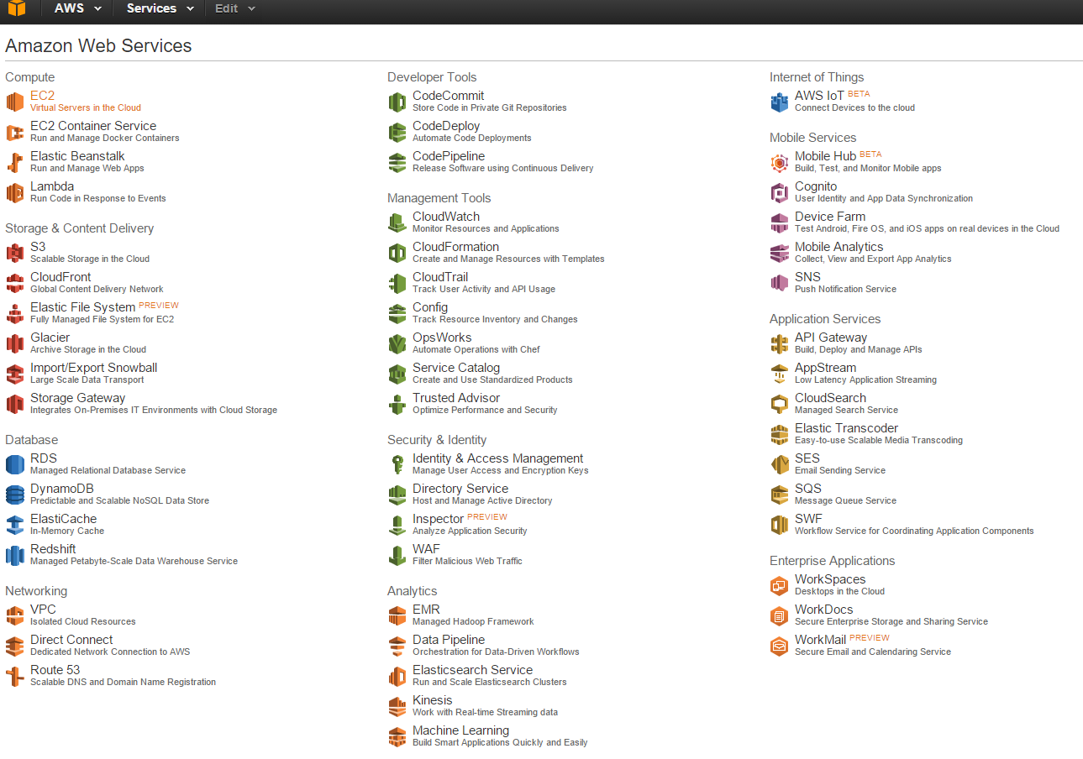
Amazon Web Services

Slide 7
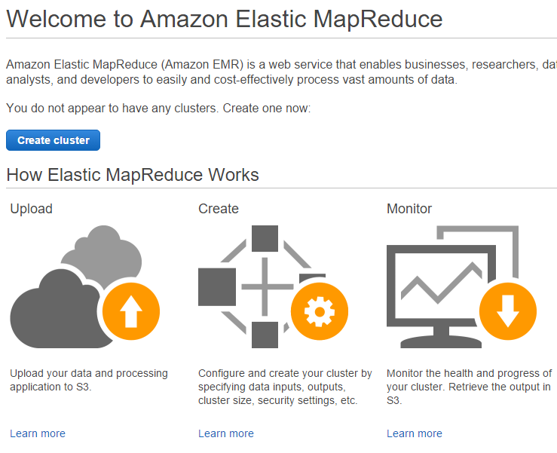

Slide 8
Get Started with Amazon EMR
You can run your cluster as a transient process:
one that launches the cluster,
loads the input data,
processes the data,
stores the output results,
and then automatically shuts down.

Slide 9
Get Started with Amazon EMR
The other model for running a cluster is as a long-running cluster:
launch a cluster and submit jobs interactively using the command line
or submit units of work called steps.
In this model, the cluster persists even when there are no steps or jobs queued for processing.

Slide 10
Create an AWS Account (we did it)
If you do not have an AWS account, to sign up for AWS:
http://aws.amazon.com and click Sign Up.
Follow the on-screen instructions.
Your AWS account gives you access to all services, but you are charged only for the resources that you use.

Slide 11
IAS = Identity and Access Management
For console access, use your IAM user name and password to sign in to the AWS Management Console using the IAM sign-in page.
IAM lets you securely control access to AWS services and resources in your AWS account.
https://www.youtube.com/watch?v=Ul6FW4UANGc

Slide 12
Create an Amazon S3 Bucket
Open the Amazon S3 console at https://console.aws.amazon.com/s3/
Click Create Bucket.
In the Create a Bucket dialog box:
Type a bucket name, such as myemrbucket. Bucket names must contain only lowercase letters, numbers, periods (.), and hyphens (-). Also, bucket names cannot end in numbers.
Select the Region for your bucket.

Slide 13
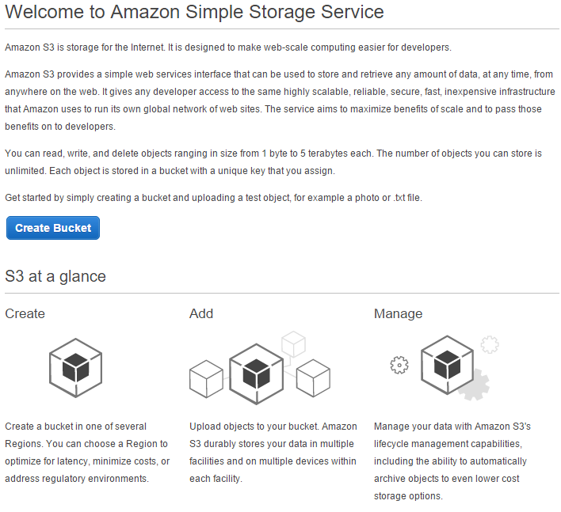
S3 = Simple Storage Service

Slide 14
What can Amazon S3 do?
Is storage for the Internet.
Simple web interface to store and retrieve any amount of data, at any time, from anywhere on the web.
Read, write, and delete files up to 5 TB each.
You can store unlimited number of objects.
Each object is stored in a bucket with a unique key that you assign.

Slide 15

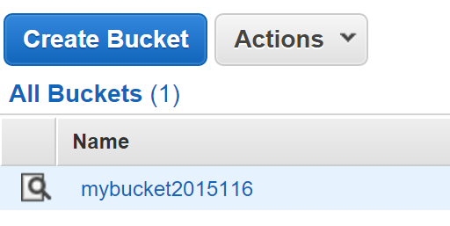
Create an Amazon S3 Bucket
Click Create.
A bucket name must be unique.
The bucket namespace is shared by all users of the system.
This creates the following path for your output data: s3://myemrbucket/mybucket2015116

Slide 16
Amazon EC2 Key Pairs
Amazon EC2 = Amazon Elastic Compute Cloud
Provides scalable computing capacity in the AWScloud.
Amazon EC2 uses public–key cryptography to encrypt and decrypt login information.
Public–key cryptography uses a public key to encrypt a piece of data, such as a password
Then the recipient uses the private key to decrypt the data.
The public and private keys are known as a key pair.

Slide 17
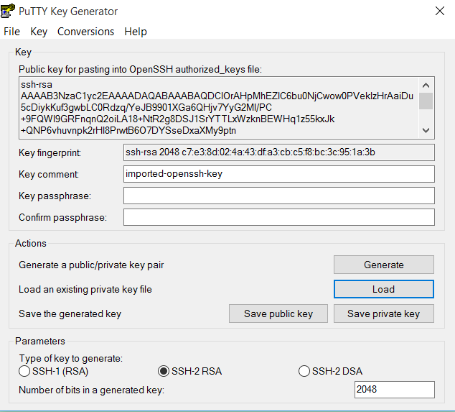
Generate Public & Private Key Pair
Download PuttyGen from Putty Download Page
http://www.chiark.greenend.org.uk/~sgtatham/putty/download.html
Start PuttyGen and click the Generate button
Click Save Public Key
Click Save Private Key
to save the key pair

Slide 18
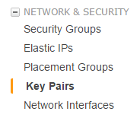

Create EC2 Key Pair
https://console.aws.amazon.com/ec2/
In the navigation bar on the left, select Key Pairs
Click on
Browse to location where you saved the key pair
Load the public key
Specify the key pair name
Import the public key

Slide 19

Cluster Options
Open the Amazon EMR console at https://console.aws.amazon.com/elasticmapreduce/
Choose
On the Create Cluster page, in the Cluster Configuration section, accept the default options.

Slide 20
Launch an Amazon EMR Cluster
Cluster name - the default name is "My cluster." You can also type a descriptive name for your cluster.
Termination protection - clusters created using the console have termination protection enabled (set to Yes).
Ensures that the cluster does not shut down due to accident or error.

Slide 21
Launch an Amazon EMR Cluster
Logging - this option determines whether Amazon EMR writes detailed log data to Amazon S3.
Log folder S3 location - you can type or browse to your Amazon S3 bucket to store the Amazon EMR logs.
Debugging creates an Amazon SQS to process debugging messages.
SQS = Simple Queue Service—fast, reliable, scalable, managed message queuing service

Slide 22
Launch an Amazon EMR Cluster
In the Tags section, leave the options blank.
Tagging allows to categorize resources using key-value pairs.
Tags on Amazon EMR clusters are propagated to the underlying Amazon EC2 instances.
In the Software Configuration section, accept the default options.

Slide 23
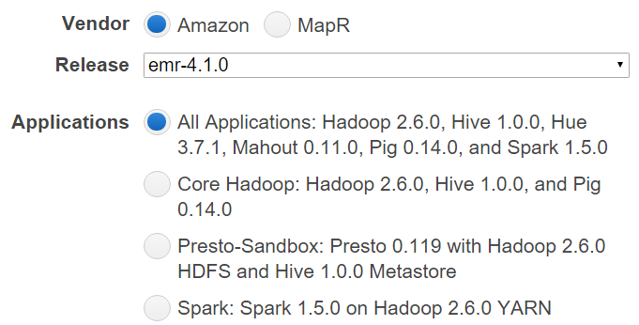
Software Configuration
Hadoop
Default—Amazon distribution of Hadoop
You can choose to run another MapR distribution
AMI version - By default, the latest Hadoop 2.x AMI is selected

Slide 24
More Settings
Applications to be installed - you can remove pre-selected applications by choosing the Remove icon.
Additional applications allows to install additional applications
Ganglia monitoring system
Cloudera Impala query engine
Hortonworks claims Hive works better
https://hortonworks.com/blog/impala-vs-hive-performance-benchmark/
Hbase distributed, scalable, big data store
Hunk visualization tool http://www.splunk.com/en_us/download/hunk.html

Slide 25
Even more settings
File System Configuration—accept defaults for EMRFS.
EMRFS is an implementation of HDFS which allows Amazon EMR clusters to store data on Amazon S3.

Slide 26
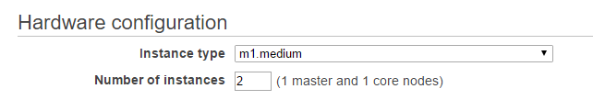
Important Section: Hardware ($$$)
In Hardware Configuration:
Choose m1.medium servers
m1.medium servers cost $0.087 per hour
Set number of instances = 2
This will extend your Amazon dollars

Slide 27
Settings for Master and Core
Master node
Amazon EMR clusters must contain only 1 master node.
Coordinates the distribution of MapReduce
Distributes subsets of raw data
Tracks the status performed tasks
Monitors the cluster health
Core nodes
Run tasks and stores data using the HDFS
A cluster must contain at least 1 core node.
Task nodes
Run tasks

Slide 28
Security Settings
Security and Access section
EC2 key pair - you should choose your Amazon EC2 key pair from the list.
SPECIFY THE KEY PAIR WHICH WAS GENERATED AND LOADED PREVIOUSLY!!!
IAM user access - makes the cluster visible and accessible to all IAM users on the AWS account.
IAM roles - generates the default EMR role and default EC2 instance profile.

Slide 29
Bootstrap Actions
Bootstrap Actions section—leave defaults
Bootstrap Actions—scripts that are executed during setup before Hadoop starts on every cluster node.
You can use Bootstrap Actions to:
Install additional software
Customize your applications.

Slide 30
Steps Settings
Steps section—accept defaults
Step is a unit of work you submit to the cluster.
Step might contain
one or more Hadoop jobs
instructions to install or configure an application.
Auto-terminate - When set to Yes, the cluster is automatically terminated after the last step is completed.

Slide 31
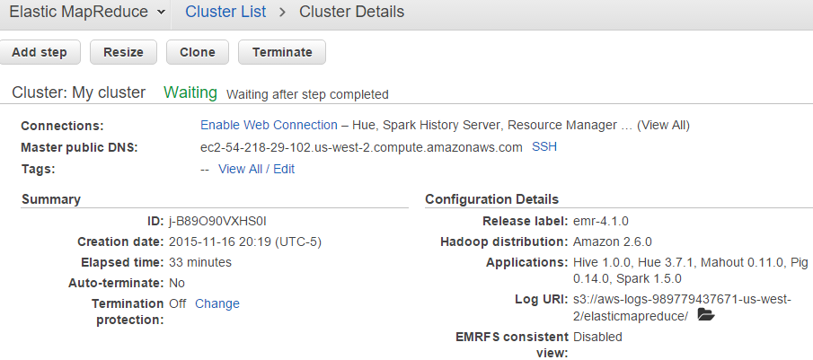
Launch an Amazon EMR Cluster
Choose Create cluster→ Cluster Details opens
Go to the next step
to run the Hive script as a cluster step
Use the Hue web interface to query your data.

Slide 32

Run a Hive Script
Open Amazon EMR console https://console.aws.amazon.com/elasticmapreduce/
In the Cluster List, click the name of your cluster.
Scroll to the Steps section and expand it, then click Add step.
In the Add Step dialog:
For Step type, choose Hive program
For Name type a new name

Slide 33
Run a Hive Script
For Script S3 location, type s3://[yourregion].elasticmapreduce.samples/cloudfront/code/Hive_CloudFront.q
Replace [yourregion] with your region
s3://us-west-2. elasticmapreduce.samples/cloudfront/code/ Hive_CloudFront.q
For Input S3 location, type s3://[yourregion].elasticmapreduce.samples
For example,
s3://us-west-2. elasticmapreduce.samples

Slide 34



Run a Hive Script
Output S3 location
Type or browse to s3://myemrbucket/output
Or the name of the bucket you created previously
Arguments—leave the field blank
Action on failure—keep default value
Click Add.
The step appears in the console with Pending status
The status changes from Pending to Running to Completed as the step runs.
To update the status, click Refresh icon above Actions column.

Slide 35

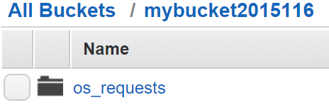

Results of the Hive Script
Open the Amazon S3 console at https://console.aws.amazon.com/s3/
Click the bucket that you used for the output
The query wrote results into folder os_requests
Make sure your browser allows pop up windows
Click os_requests

Slide 36
Getting Hive Results
The Hive query results are stored in a text file.
To download the file:
right-click on it
choose Download
right-click the Download link
choose Save Link As
And save the file to your PC.
Open the file using a text
In the output file, you should see the results of the query we executed
That query returns the number of access requests by operating system.

Slide 37
Create an SSH Tunnel
To connect to Hue and run the script:
Connect to the master node via SSH
Establish a tunnel to the Hue interface running on port 8888.
Creating the SSH connection requires:
An SSH client
PuTTY (Windows) or OpenSSH (Linux, Mac OS X)
An Amazon EC2 key pair private key file
.ppk for Windows
or .pem for Linux and Mac OS X

Slide 38
Create an SSH Tunnel with PuTTY
Open the Amazon EMR console at https://console.aws.amazon.com/elasticmapreduce/
In the console, on the Cluster List page, click the link for your cluster.
Note the Master public DNS value that appears at the top of the Cluster Details page.
This value is required to establish your SSH connection.
Launch PuTTY.

Slide 39
Connecting with PuTTY (continued)
In the Host Name (or IP address) field, type hadoop@MasterPublicDNS like this:
hadoop@ec2-###-##-##-###.compute-1.amazonaws.com
In the Category list
Expand Connection > SSH
Then click Auth
For Private key file for authentication
click Browse and select the private .ppk key we generated earlier

Slide 40
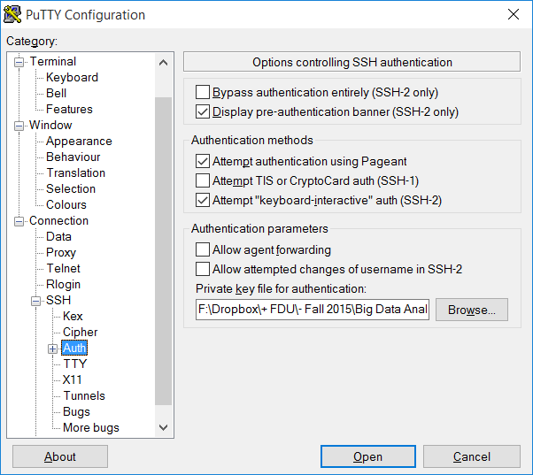
Connecting with PuTTY (continued)

Slide 41
Connecting with PuTTY (continued 2)
In the Category list, expand
Connection > SSH, and then click Tunnels
In the Source port field, type an unused local port number, for example 8157.
In the Destination field, type MasterPublicDNS:8888 to access the Hue interface, for example
ec2-###-##-##-###.compute-1.amazonaws.com:8888
Leave the Local and Auto options selected.
Click Add

Slide 42
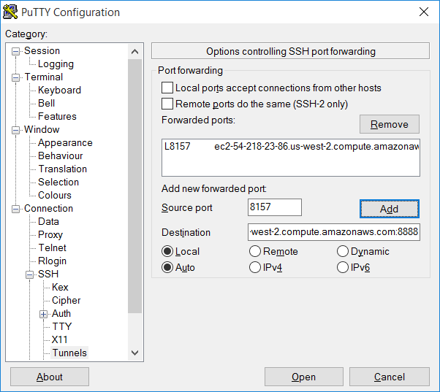
Connecting with PuTTY (continued 2)
You should see an entry in the Forwarded ports field similar to:
L8157
ec2-###-##-##-###.compute-1.amazonaws.com:8888

Slide 43
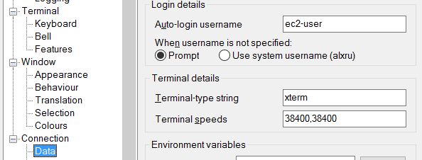
Connecting with PuTTY (continued 3)
Expand Connection and click on Data
Enter ec2-user into the Auto-login username
Click Open and then click Yes to dismiss the PuTTY security alert.

Slide 44
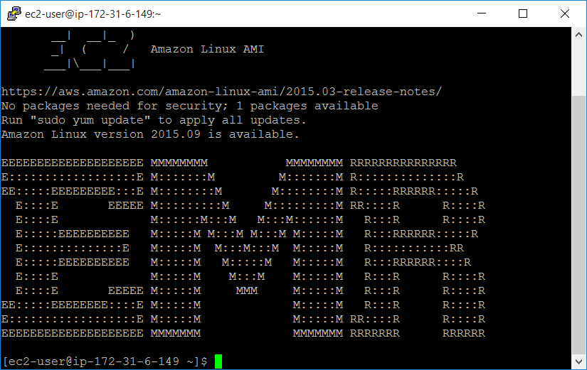
Putty Login Confirmation
If everything was entered correctly and you logged in successfully, you will see a similar screen

Slide 45
Run Hive script in Hue
Type the following URL in your browser: http://localhost:8157
Hue welcome page will be displayed
Type a Username and Password.
These name and password will become Hue superuser credentials.
The password:
must be at least 8 characters long
must contain both uppercase and lowercase letters
at least one number
and at least one special character.
If the page does not show, disable your firewall (in your antivirus and/or in Windows)

Slide 46
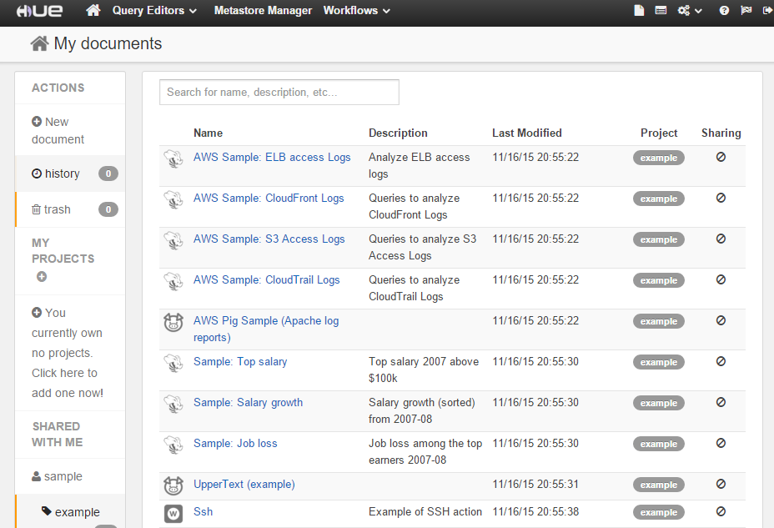
Hive in AWS
If everything was right, a similar page will show up

Slide 47
Run a Hive Query in Hue
From the menu options, choose
Query Editors > Hive
Delete the sample text and type:
SELECT description, max(salary), min(salary), avg(salary), count(*)
FROM sample_07
GROUP BY description
Click the Execute button

Slide 48
Hive Query Execution
As the query runs,
log entries are displayed on the Log tab in the window below.
When the query completes, the Results tab is displayed.
Review the output data from the query.
After examining the output,
close your browser,
or as time permits, continue to explore Hue.

Slide 49

Hive Query Results

Slide 50
Delete Amazon S3 bucket
Completed clusters are automatically removed after two months.
Open the Amazon S3 console at https://console.aws.amazon.com/s3/.
To delete a bucket, you must first delete all of the objects in it. Click the bucket that stores your logs and output data.
Use the SHIFT or CRTL keys to select all the objects in the bucket.

Slide 51
Delete Amazon S3 bucket
Right-click and choose Delete or click Actions > Delete.
Click OK to confirm the deletion when prompted.
Click All Buckets in the breadcrumb trail at the top of the window.
Right-click the bucket, choose Delete, and then click OK to confirm the deletion when prompted.

Slide 52
Terminate Amazon EMR cluster
Open the Amazon EMR console at
https://console.aws.amazon.com/elasticmapreduce/
On the Cluster List page, select your cluster by clicking the check box, and then click Terminate.
By default, clusters created using the console are launched with termination protection enabled.
In theTerminate clusters dialog, for Termination protection, click Change.
Click Off and then click the check mark to confirm the change.
Click Terminate.

Slide 53
Plan an Amazon EMR Cluster
The type of source data that you want to process
The amount of source data and how you want to store it
The acceptable duration and frequency of processing source data
The network configuration and access control requirements for cluster connectivity
The metrics for monitoring cluster activities, performance, and health
The software that you choose to install in your cluster to process and analyze data
The cost to run clusters based on the options that you choose

Slide 54
Choose an AWS Region
Choose a region to reduce latency, minimize costs, or address regulatory requirements.
The list of regions and endpoints supported by Amazon EMR:
http://docs.aws.amazon.com/general/latest/gr/rande.html
For best performance, use the same region for all of your AWS resources that will be used with the cluster.

Slide 55
Choose an AWS Region
using the console:
to the right of your account information on the navigation bar
using the AWS CLI:
use either the aws configure command or the AWS_DEFAULT_REGION environment variable
Using an SDK or the API:
example: client.setEndpoint("eu-west-1.elasticmapreduce.amazonaws.com");

Slide 56
Number and Type of Instances
There are up to three types of server roles in a Amazon EMR cluster: master, core, and task:
A single master node manages the cluster (doesn't require much processing power).
Core nodes both process data and store data in HDFS (need both processing power and storage.).
Task nodes are optional, and only process data (need only processing power).

Slide 57
Number and Type of Instances
To calculate the HDFS capacity of a cluster, multiply the storage capacity of the EC2 instance type you've selected by the number of nodes and divide the total by the replication factor for the cluster.
The replication factor is 3 for a cluster of 10 or more nodes, 2 for a cluster 4-9 nodes, and 1 for a cluster with 3 or fewer nodes.
The total number of EC2 instances you can run on a single AWS account is 20.

Slide 58
Instance Configurations
Amazon EC2 offers several basic types:
General purpose— use Amazon EC2 general purposes instances for most applications.
Compute optimized—proportionally more CPU resources than memory (RAM) for compute-intensive applications. Cluster compute instances also have increased network performance.

Slide 59
Instance Configurations
Memory optimized—large memory sizes for high throughput applications, including database and memory caching applications.
Storage optimized—proportionally high storage resources. They are well suited for data warehouse applications.
GPU instances—compute resources for increased parallel processing performance with GPU-assisted applications.

Slide 60
Instance Class | Instance Types
General purpose | m1.small (Hadoop 1 only) | m1.medium | m1.large | m1.xlarge | m3.xlarge | m3.2xlarge
Compute optimized | c1.medium | c1.xlarge | c3.xlarge | c3.2xlarge | c3.4xlarge | c3.8xlarge | cc2.8xlarge
Memory optimized | m2.xlarge | m2.2xlarge | m2.4xlarge | r3.xlarge | r3.2xlarge | r3.4xlarge | r3.8xlarge | cr1.8xlarge
Storage optimized | hi1.4xlarge | hs1.2xlarge | hs1.4xlarge | hs1.8xlarge | i2.xlarge | i2.2xlarge | i2.4xlarge | i2.8xlarge | d2.xlarge | d2.2xlarge | d2.4xlarge | d2.8xlarge
GPU instances | g2.2xlarge | cg1.4xlarge

Slide 61
Configure the Software
Amazon EMR uses an Amazon Machine Image (AMI) to install software on the instances that it launches in the cluster.
AMI Version 3.10.0 (2 October 2015) includes AWS SDK for Java 1.9; AWS SDK for Ruby 1.9; Amazon Linux version 2015.03; Hadoop 2.4.0; Hive 0.13.1; Hue 3.7.1; Pig 0.12.0; Hbase 0.94.18; Impala 1.2.4; Mahout 0.9; Java: Oracle/Sun jdk-7u76; Perl 5.16.3; PHP 5.6.9; Python 2.6.9; R 3.1.1; Ruby 2.0; Scala 2.11.1; Spark 1.3.1

Slide 62
Bootstrap Actions
You can use a bootstrap action to install additional software and to change the configuration of applications on the cluster.
Bootstrap actions are scripts that are run on the cluster nodes when Amazon EMR launches the cluster.
You can create custom bootstrap actions or use predefined bootstrap actions.

Slide 63
File Systems
HDFS (hdfs://) - used by the master and core nodes. It's best used for caching the results produced by intermediate job-flow steps.
EMRFS (s3://) - implementation of HDFS used for reading and writing regular files from Amazon EMR directly to Amazon S3.
Local file system - ideal for storing temporary data that is continually changing.
Amazon S3 block file system (s3bfs://) - not recommended to usual use.

Slide 64
Cluster Lifecycle
Transient process:
launches the cluster,
loads the input data,
processes the data,
stores the output results,
automatically shuts down.
You are only billed for the time required to process your data.

Slide 65
Cluster Lifecycle
Long-running cluster:
the cluster launches
loads the input data.
The cluster persists even when there are no tasks queued for processing.
You must disable auto-termination for this cluster.

Slide 66
Prepare Input Data
The default input format for a cluster is text files with each line separated by a newline (\n) character.
You can use the Hadoop interface InputFormat to specify other input types.
You can use Informatica's HParser to convert the data to text or XML format (in case PDF and Word files).
If you are using Hive, you can use a serializer/deserializer (SerDe).

Slide 67
Prepare Input Data
Amazon EMR provides several ways to get data onto a cluster:
Upload Data to Amazon S3
Import files with Distributed Cache
Process Compressed Files
Import DynamoDB Data into Hive
Connect to Data with AWS DirectConnect
Upload Large Amounts of Data with AWS Import/Export

Slide 68
Prepare an Output Location
Output format of an Amazon EMR cluster is as text files (compressed or uncompressed).
Files are written to an Amazon S3 bucket.
Specify the S3 bucket as the output location when you launch the cluster.
Use the Hadoop interface OutputFormat to specify other output types.
On Hive cluster, use a serializer/deserializer (SerDe) to output data from HDFS to a given format.

Slide 69
Configure Access to the Cluster
AWS Identity and Access Management (IAM) create user accounts and roles and configure permissions.
Two IAM roles, a service role and an instance profile, are required for cluster.
Associate an EC2 key pair with the cluster that you can use to connect to the cluster using SSH.
You can also set permissions that allow users other than the default Hadoop user to submit jobs to your cluster.

Slide 70
Another Way to Create an Amazon EC2 Key Pair
Sign in to the AWS Management Console at https://console.aws.amazon.com/ec2/.
From the Amazon EC2 console, select a Region.
In the Navigation pane, click Key Pairs.
On the Key Pairs page, click Create Key Pair.
In the Create Key Pair dialog box, enter a name for your key pair, such as, mykeypair.
Click Create.
Save the resulting PEM file in a safe location.

Slide 71
Modify credentials file
Linux, UNIX, or Mac OS X | Set the permissions on the PEM file or your Amazon EC2 key pair. For example, chmod og-rwx mykeypair.pem
Microsoft Windows | Launch PuTTYgen. Click Load. Select the PEM file you created earlier. Click Open. Click OK on the PuTTYgen Notice telling you the key was successfully imported. Click Save private key to save the key in the PPK format. When PuTTYgen prompts you to save the key without a pass phrase, click Yes. Enter a name for your PuTTY private key, such as, mykeypair.ppk. Click Save. Exit the PuTTYgen application.

Slide 72
Configure cluster access
Open the Amazon EMR console
Choose Create cluster.
In the Security and Access section, in the IAM User Access field, choose All other IAM users to make the cluster visible and accessible to all IAM users on the AWS account (the default option). Choose No other IAM users to restrict access.

Slide 73
IAM policies and roles
The ability for IAM users to perform certain actions with Amazon EMR is controlled by IAM policies (Full Access Policy, Read-Only Access Policy).
Specify two IAM roles for a cluster: a role for the Amazon EMR service (service role), and a role for the EC2 instances (instance profile).
Three ways to create IAM roles:
Amazon EMR console,
AWS CLI,
IAM console or API

Slide 74
Security Groups
There are two types of security groups for your EC2 instances:
Amazon EMR–managed security groups for the master and core/task instances: you can choose the default master and core/task security groups, or you can specify your own security groups
Additional security groups: you can specify security groups that apply to your Amazon EC2 instances in addition to the Amazon EMR–managed security groups

Slide 75
Logging and Debugging
A cluster generates several types of log files:
Step logs —contain information about the cluster and the results of each step.
Hadoop logs — contain information about Hadoop jobs, tasks, and task attempts.
Bootstrap action logs — the log files are stored in /mnt/var/log/bootstrap-actions/ on the master node.
Instance state logs — these logs provide information about the CPU, memory state, and garbage collector threads of the node.

Slide 76
Logging and Debugging
To have the log files archived to Amazon S3, you must enable this feature when you launch the cluster using the console, the CLI, or the API.
The debugging tool is a graphical user interface
To be able to use the graphical debugging tool, you must enable debugging when you launch the cluster.
You can do this using the console, the CLI, or the API.

Slide 77
Amazon VPC Subnet
The reasons to launch your cluster into a virtual private cloud (VPC) include the following:
Processing sensitive data
Launching a cluster into a VPC is similar to launching the cluster into a private network with additional tools.
Accessing resources on an internal network
For example, if you have an Oracle database in your data center.

Slide 78
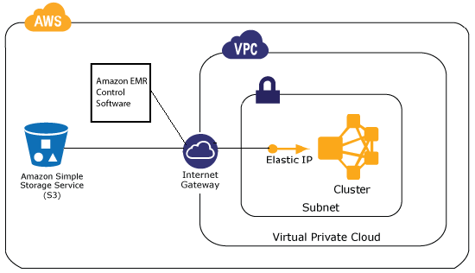
Amazon VPC Subnet

Slide 79
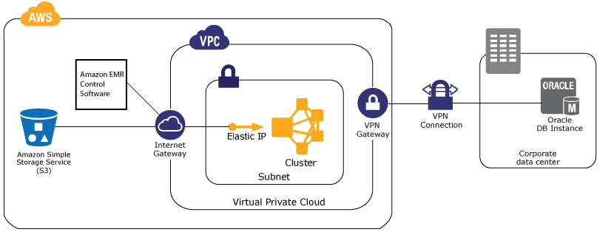
Amazon VPC Subnet

Slide 80
Tagging Amazon EMR Clusters
A tag consists of a key and a value, both of which you define. For Amazon EMR, the cluster is the resource-level that you can tag.
When you add a tag to an Amazon EMR cluster, the tag is also propagated to each active Amazon EC2 instance associated with the cluster.
Use the Amazon EMR console or CLI to manage tags on Amazon EC2 instances.

Slide 81
Tag Restrictions
The maximum number of tags per resource is 10.
The maximum key length is 127 Unicode characters.
The maximum value length is 255 Unicode characters.
Tag keys and values are case sensitive.
Do not use the aws: prefix.
You cannot change or edit tags on a terminated cluster.
A tag value can be an empty string, but not null. In addition, a tag key cannot be an empty string.

Slide 82
Third Party Applications
You can run several popular big-data applications on Amazon EMR with utility pricing:
Business intelligence tools (Microsoft Excel, MicroStrategy, QlikView, and Tableau)
Hunk
Informatica's Hparser
MapR

